Slide 1
Walk Through: Public Service Loan Forgiveness(PSLF) Application
Office of Financial Aid and Scholarships

Slide 2
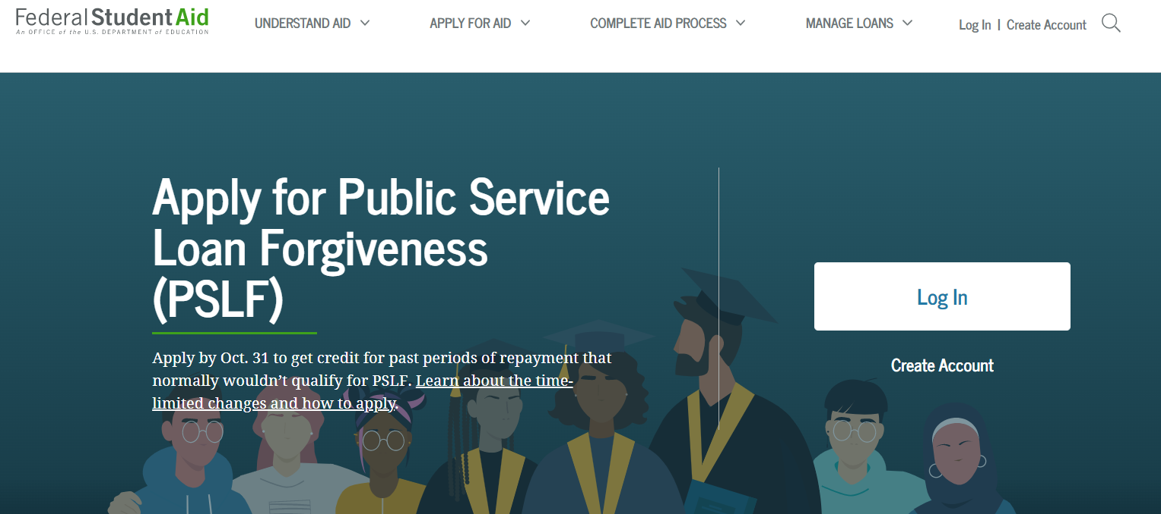
1. Go to StudentAid.gov
Click Log In or Create Account
If you are trying to log-in to StudentAid.gov and it isn’t recognizing your account, try ‘Create Account’ as profiles not accessed since before 2015 have been deleted with their new system
If you create an account, you must wait 1-3 days for the Social Security verification

Slide 3
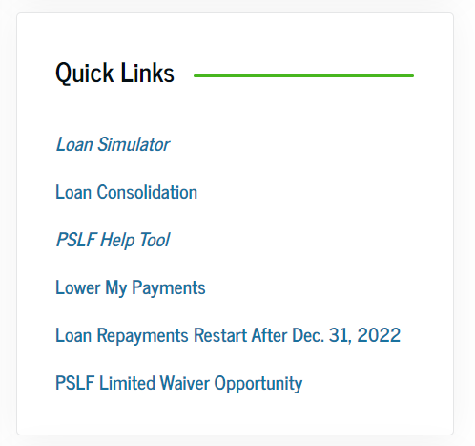
2. Once logged in, you should be brought to your StudentAid.gov dashboard. Scroll down to Quick Links and click on PSLF Help Tool
If you don’t see it the direct link to the PSLF Help Tool (Application) is: https://studentaid.gov/pslf/

Slide 4
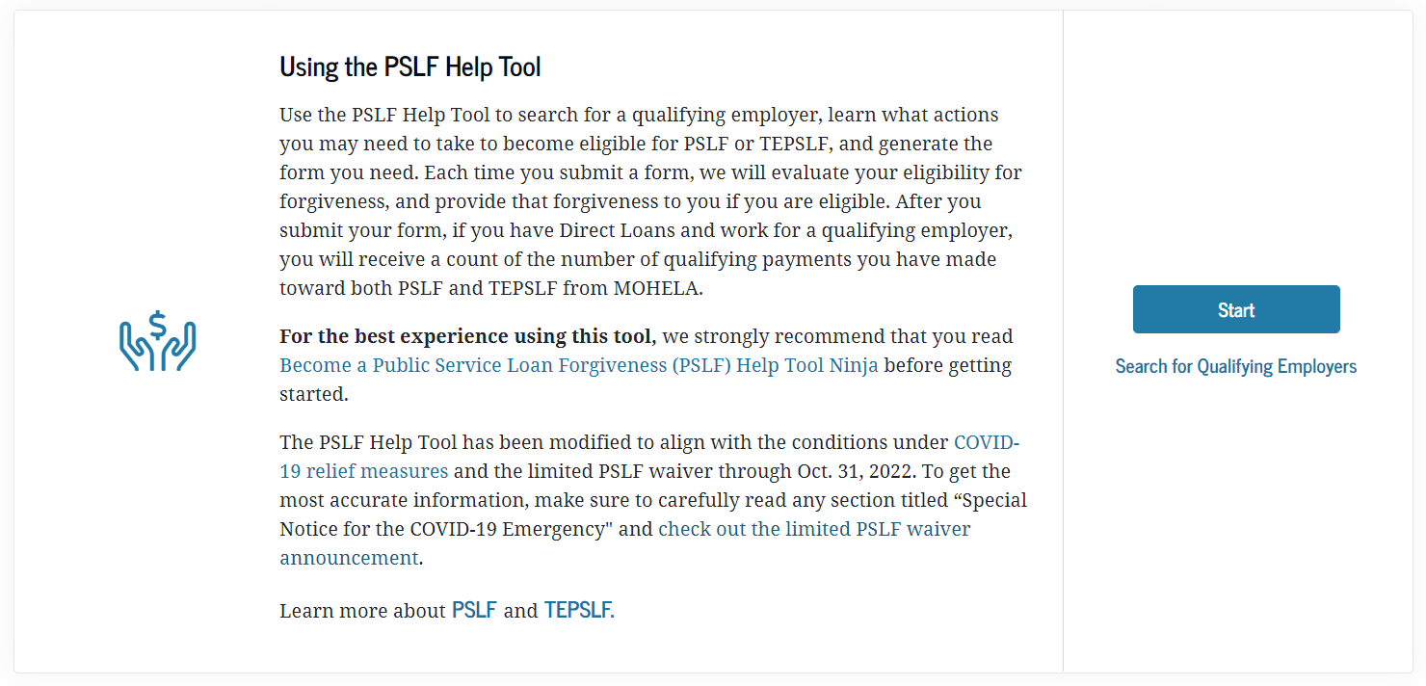
3. Click Start

Slide 5
This tool will examine the loan status, loan types, and repayment plans we have on file for you. This tool will help you determine whether your loans are set up for success or if there are actions you should take to benefit from the program.
After 10 years of making qualifying payments while working at a non-profit, you may qualify for PSLF

Slide 6
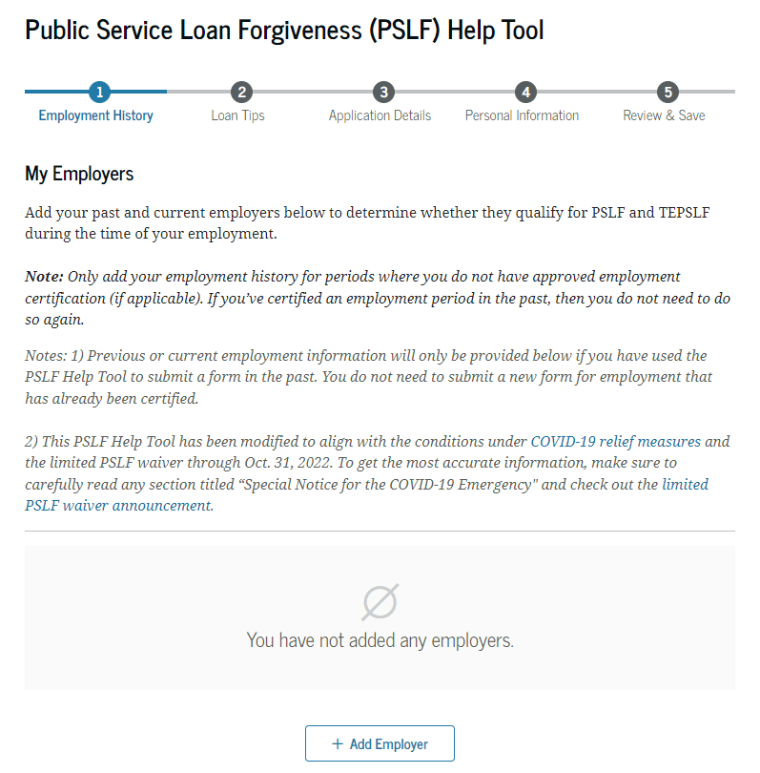
Part 1. Employment History
Click Add Employer. You must have your employer and/or previous employers Employer ID Number (Found on W2, box B), if they were also a non-profit, and you have been at your current non-profit for less than ten years

Slide 7
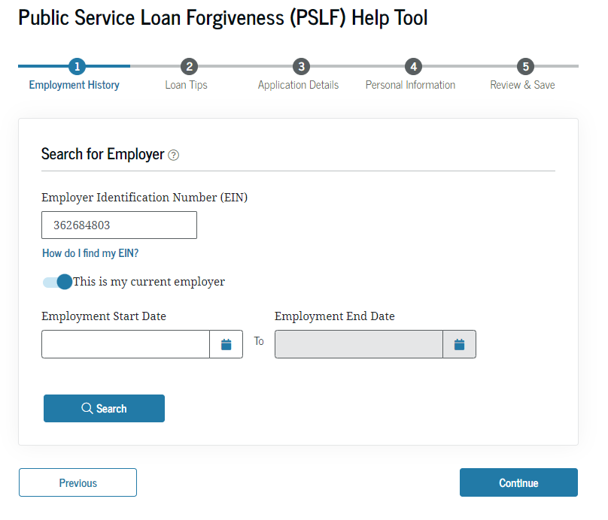
Part 1. Cont’d: Fill in Info for Each Employer
You will enter the EIN number, if this is a current or former employer, and then employment dates
Click Search

Slide 8
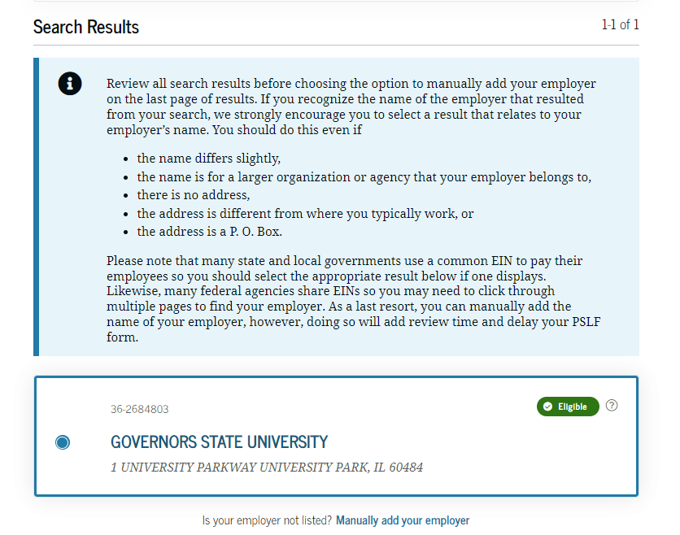
Part 1. Cont’d: Verify it’s the Correct Employer
Once you click Search, your employer will come up. If that’s the correct employer, click the ratio button and then click next. If your employer is not recognized, you will be able to enter the info in manually

Slide 9
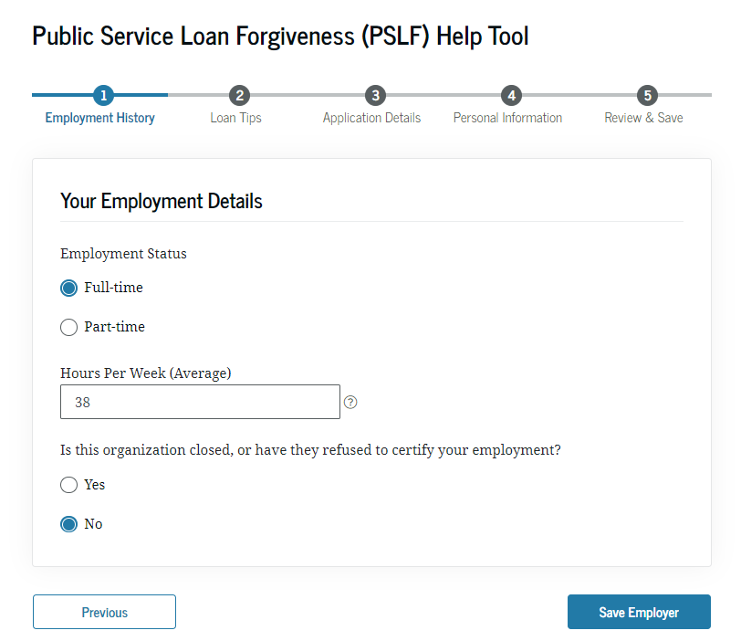
Part 1. Cont’d: Enter Employment Details

Slide 10
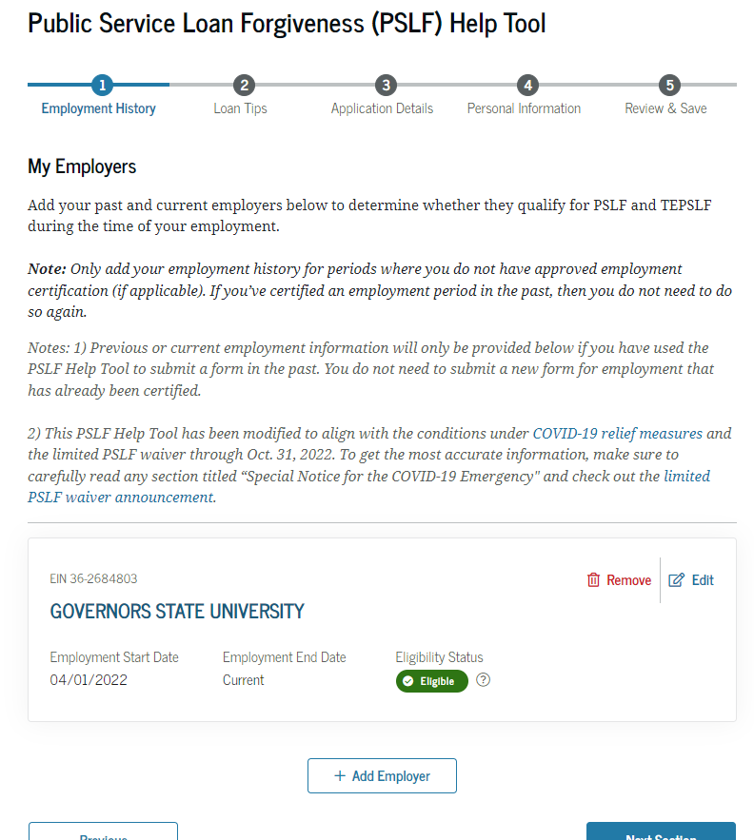
Part 1. Cont’d: Verify
Employment Details
You can click edit if you need to make adjustments, or click Next Section to proceed to section 2: Loan Tips

Slide 11
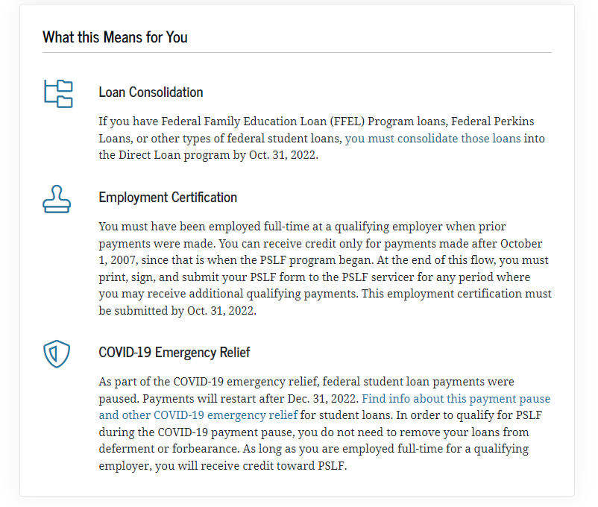
Part 2. Loan Tips
This part will discuss which loans apply to PSLF and which must be consolidated to qualify

Slide 12
Eligibility Requirements: #1
#1-ELIGIBLE LOANS
Make sure all your loans are eligible!
DIRECT Subsidized & Unsubsidized Loans
DIRECT Grad/PLUS & Parent PLUS Loans
DIRECT Federal Consolidation Loans
*NON-Eligible Loans: (Federal Family Education Loan) FFEL Stafford, FFEL Grad PLUS, FFEL Federal Consolidation, Perkins, also DHHS loans: LDS and PCL
*You may make some Non-Eligible Loans, eligible for PSLF, by consolidating them into a DIRECT Federal Consolidation Loan (FFEL loans, Perkins & LDS)
Note: Defaulted Loans, Private Loans, PCL loans & Consolidation Loans that contain a spousal Consolidation Loan are not eligible

Slide 13
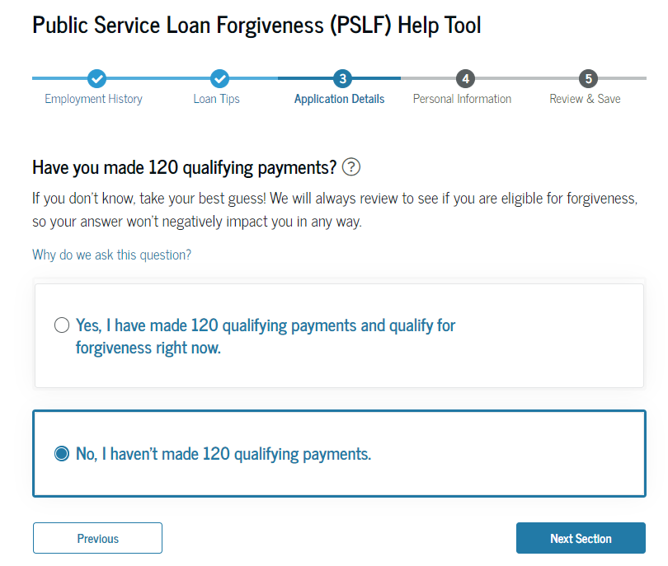
Part 3. Application Details
This part will ask if you believe you’ve made 120 qualifying payments.
Click Next Section

Slide 14
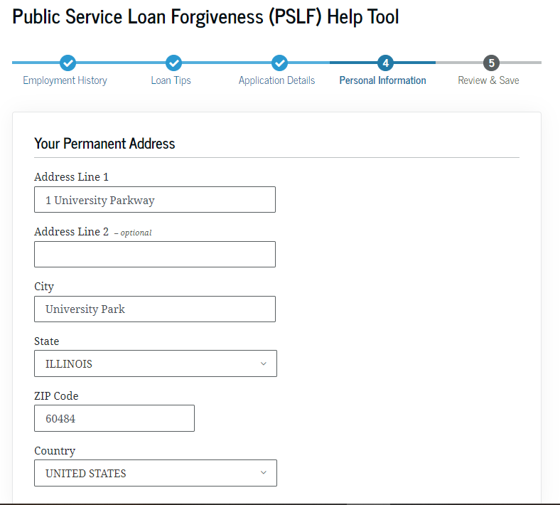
Part 4. Personal Information
This part will verify your personal information and allow you to update.
Click Continue once you’ve verified all is correct

Slide 15
Part 5. Review and Save
This part will allow you to verify all information is correct. If all looks correct, click Save.

Slide 16
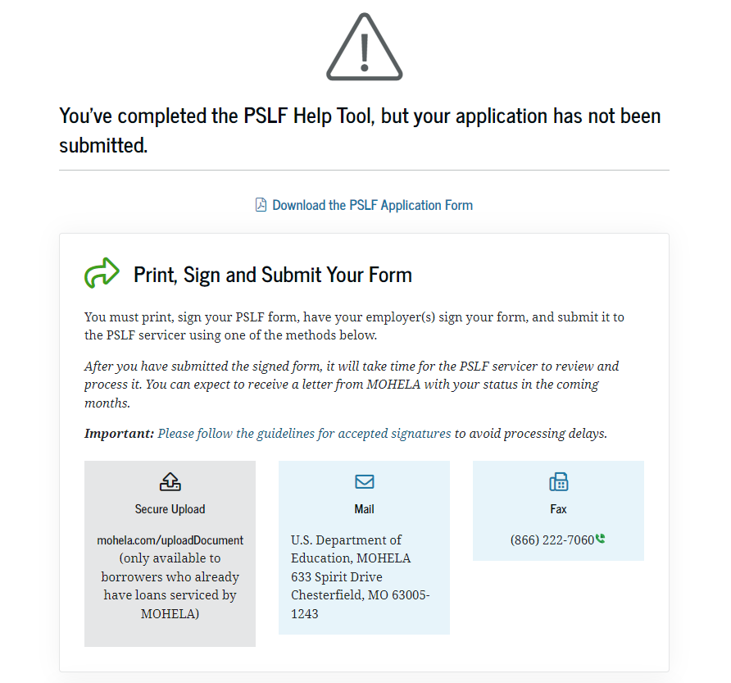
You should land on this page below
You must now download and print the application.

Slide 17
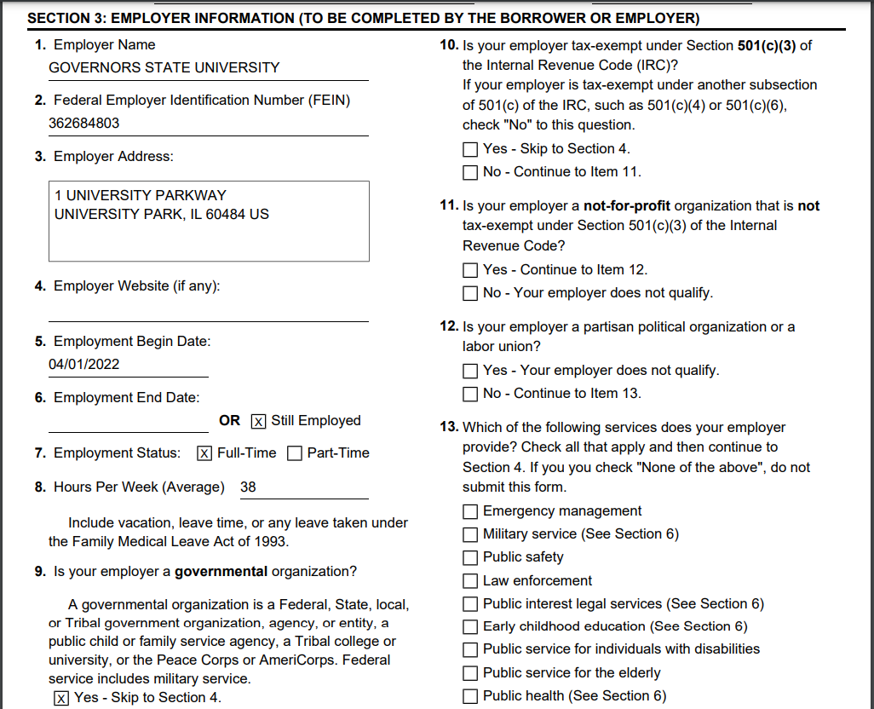
Filling out the Printables
You must sign page 3 that says Borrower’s Signature.
You will fill out Page 4: SECTION 3: EMPLOYER INFORMATION
If you’re struggling with Section 3, your HR department will be able to assist you.

Slide 18
Cont’d: Filling out the Printables
Your HR department will sign section 4: Employer Certification

Slide 19
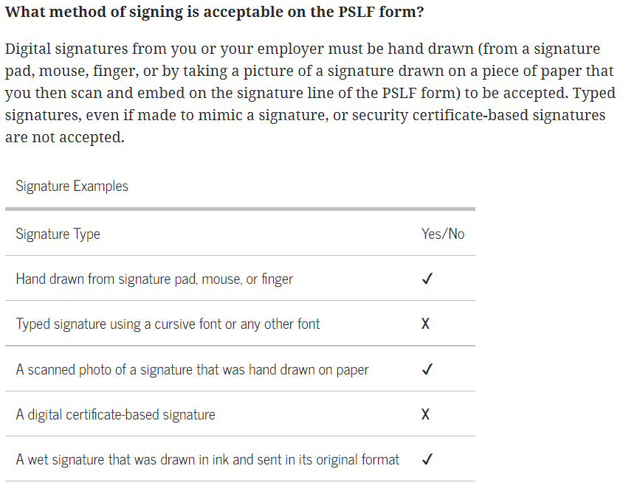
Cont’d: Filling out the Printables
What signatures are OK?
https://studentaid.gov/manage-loans/forgiveness-cancellation/public-service/questions

Slide 20
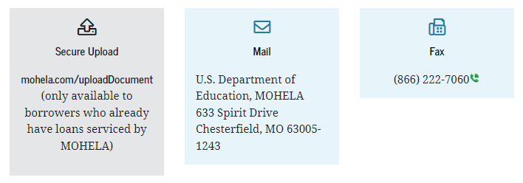
What now?
You will scan the signed application and make a copy for yourself. You can submit it one of three ways:
Once submitted, it can take up to six weeks to hear back.

